Slide 1





The Shale Network
Welcome!
The ShaleNetwork will create a central and accessible repository for geochemistry and hydrology data collected by watershed groups, government agencies, industry stakeholders, and universities working together to document natural variability and potential environmental impacts of shale gas extraction activities.

Slide 2
The Shale Network Workshop
Susan L. Brantley, Kathy Brasier, Dave Yoxtheimer, Maggie Peacock, Paul Grieve (Penn State)
Candie Wilderman, Julie Vastine (Dickinson College, ALLARM)
Jorge Abad, Radisav Vidic, Cesar Simon, Sina Armand (Pitt University)
Rick Hooper, Jon Pollak (CUAHSI)
May 20 2013
Many thanks to Debbie Lambert and Tracy Bernier as well

Slide 3
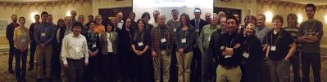
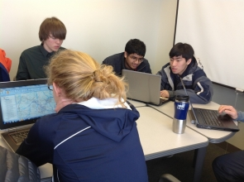
Many other participants have contributed ideas, help, time, and data
Photo from the annual Shale Network workshop April 2012 (shalenetwork.org). Next workshop: May 19-20, 2013
Teen Shale Network includes high school students from State College High School PA (Teacher Nell Herrmann) and Mountain Ridge High School WV (Teacher Tom Kozikowski)

Slide 4
Goals of the Workshop
To explain to you what we are doing
To learn from you what you are doing
To learn together how to make our efforts more meaningful and important for people to understand potential impacts of hydraulic fracturing on water quality and quantity in regions of shale gas develoment in the northeast

Slide 5
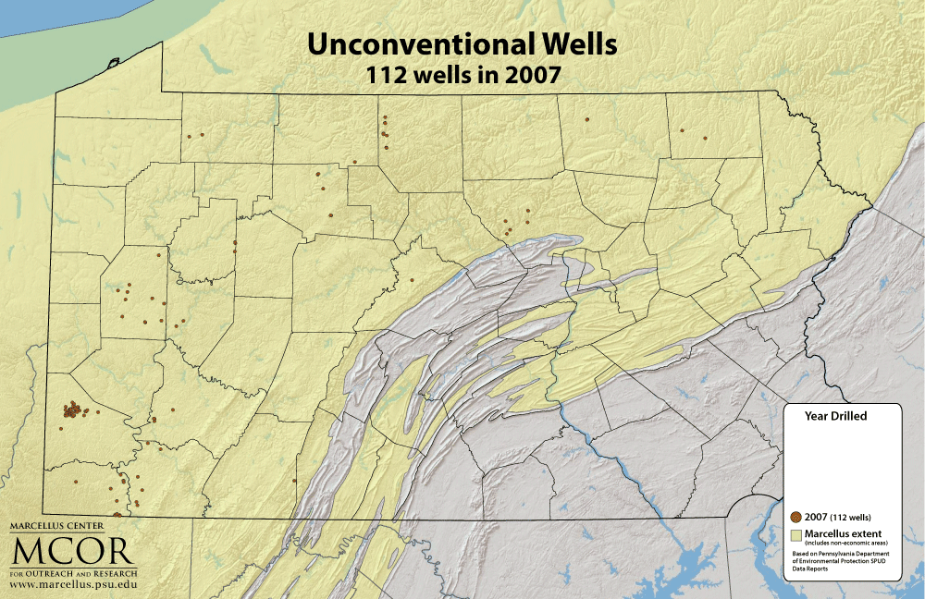
Notes:
Since 2003, 5,900 unconventional gas wells have drilled with approximately 2,875 producing wells as of June 2012.
2007, 112
2008, 445
2009, 1260
1010, 2874
2011, 4849
2012, 5674

Slide 6

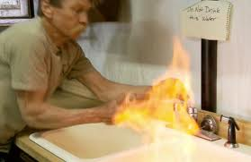

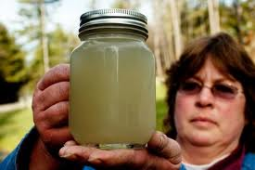
Incidents that have happened have created public push-back
Notes:
Univ of Buffalo report released May 15 2012 said that it examined 3000 violoations from 4000 gas wells since 2008 in PA. 62% were administrative and 38% were environmental. The enviro violoations stemmed from 845 events – 25 classified as major like site rsstoration failutres, serious contamination of water supplies, major land spills, blowouts, and venting and gas migration. Overall number of violations tripled from 99 in 2008 to 331 in the first eight months of 2011 as number of wells rose from 170 to 1200. But % dropped from 58.2 to 30.5 (2008 to 2010). Lead author Tim Considine.

Slide 7
Our Hypothesis
An online, shared compilation of water quality and quantity data collected by citizen scientists, government agencies, industry, and university personnel in areas of shale gas production will pull people together and provide the understanding needed to make good decisions.

Slide 8
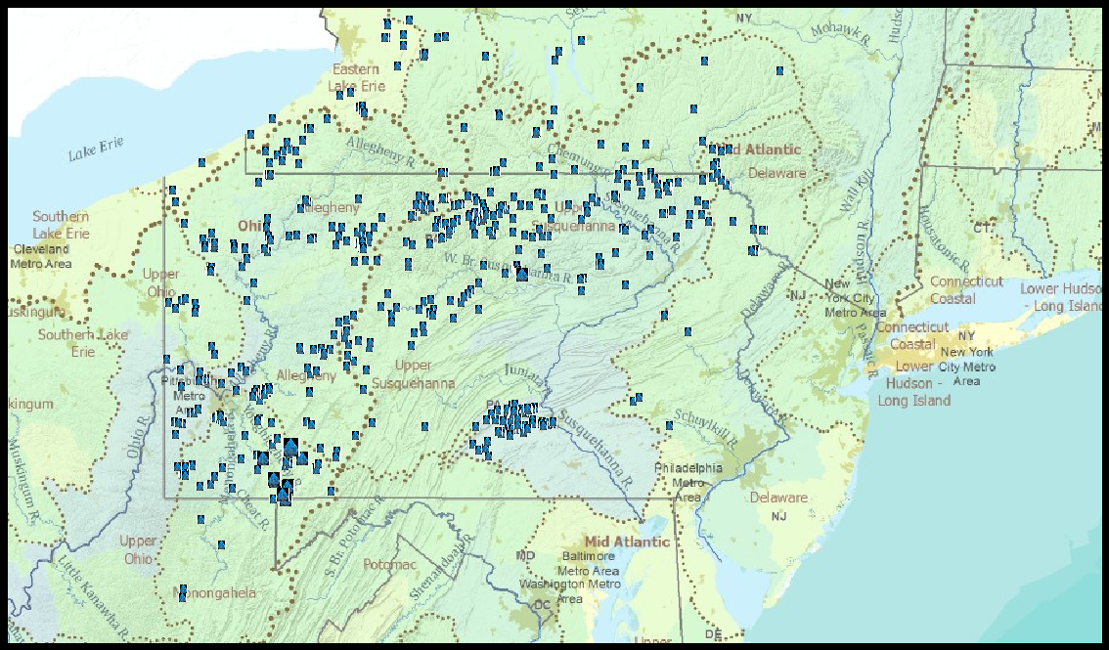
We are building the ShaleNetwork database as a HydroServer in the CUAHSI Hydrological Information System (NSF facility). CUAHSI’s tool, HydroDesktop, allows people to find the data along with data such as USGS NWIS and EPA STORET. Below: all locations for which Shale Network uploaded data from 10/11 – 12/12
By putting Shale Network data (shalenetwork.org) into the CUAHSI Hydrologic Information System (cuahsi.org), it can be easily accessed with all the other data that are available, using HydroDesktop.
Notes:
Map of all the sites where shale network has data. How many sites are there? How many analytes?

Slide 9
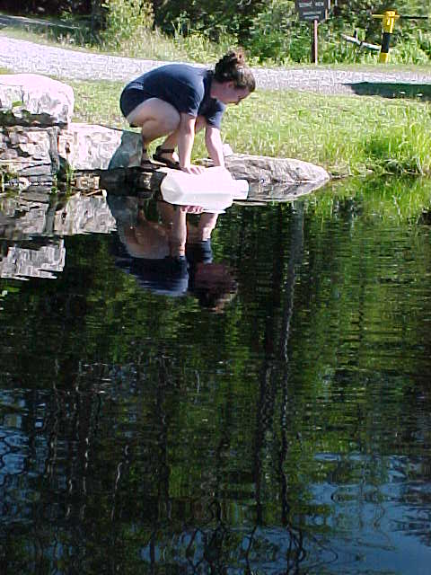
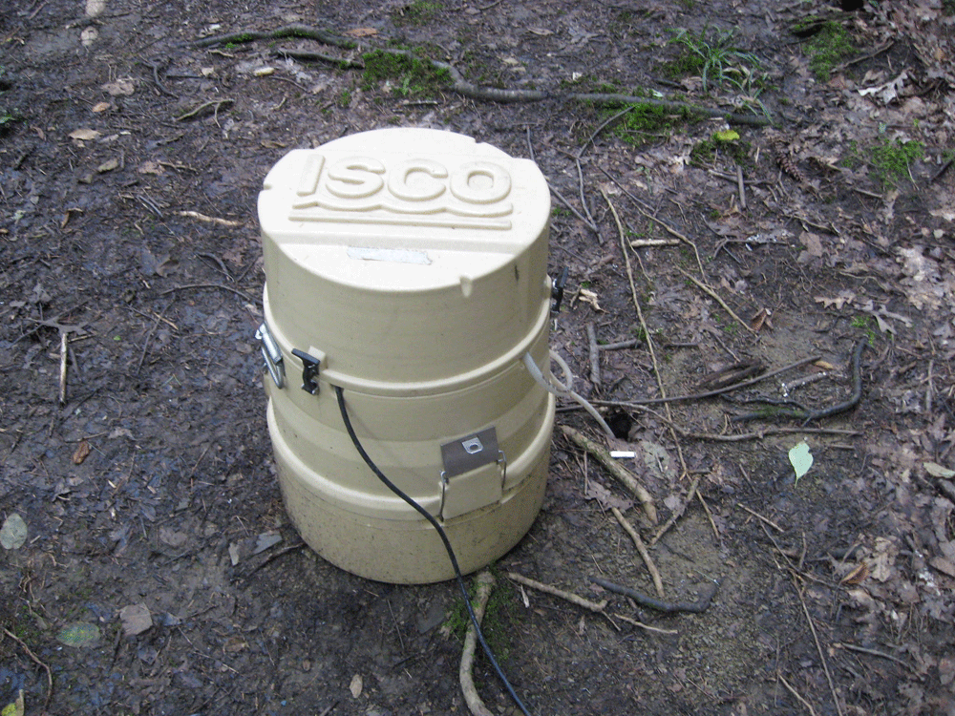
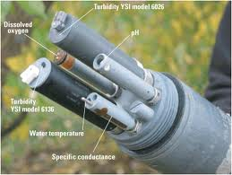
What types of measurements are we including in the database?
Water quantity: discharge rates or stage height, etc
Sensor data (water quantity, water quality)
Analyses of collected samples: ISCO or grab samples
Samples can be collected on a sporadic or regular basis

Slide 10
Summary: A list of our goals and our progress
Goal 1, To identify groups collecting water data in region of shale-gas extraction (starting with Marcellus): See our homepage at shalenetwork.org
Goal 2, Create a sustainable network of the groups by hosting an annual meeting: Welcome to our second annual meeting and please use our forum
Goal 3, Work with CUAHSI to create a database that can establish background and can document impacts: See ShaleNetwork data by using HydroDesktop
Goal 4, Train two graduate students in database development and use for communities: Please be sure to meet Cesar Simon (Pitt Univ) and Paul Grieve (Penn State)
Goal 5, Facilitate community groups in collecting, organizing, and interpreting their data: We are working with ALLARM and with two high schools to input data from citizen scientists
Goal 6, Evaluate hydrogeochemical data using GIS in relation to population and economic data: We are working to assess ShaleNetwork data

Slide 11
Conclusions from Last Year’s Workshop
1) Extensive data have been collected for areas of shale gas development, but data are hard to access
2) We need to encourage government and industry to publish data online
3) We can use database to assess data gaps and needs
4) We need to prioritize which data to find and upload
5) The database should be maintained even beyond the three years of NSF funding for Shale Network
6) The development of the database will help to forge agreements among data providers to standardize or simplify metadata requirements
7) An interface is needed – other than HydroDesktop -- that allows non-scientists to interact with the data

Slide 12
What about data quality?
We seek data from any group using established data protocols -- from industry sources, government sources, university sources, nonprofits, citizen scientists
Our basic philosophy is that even published peer-reviewed or gov’t data has problems associated with it, so as much as possible we want to put data online with appropriate metadata for researchers to assess…THE BEST WAY TO ASSURE DATA QUALITY IS TO PUT IT ONLINE FOR SCRUTINY
The metadata includes as much information as possible about data quality
If problems are found in data we will note it and possibly remove the problematic data
Publications will be noted where they are available; likewise, use of ALLARM protocol will be noted for citizen groups (and some such protocol will be required)

Slide 13
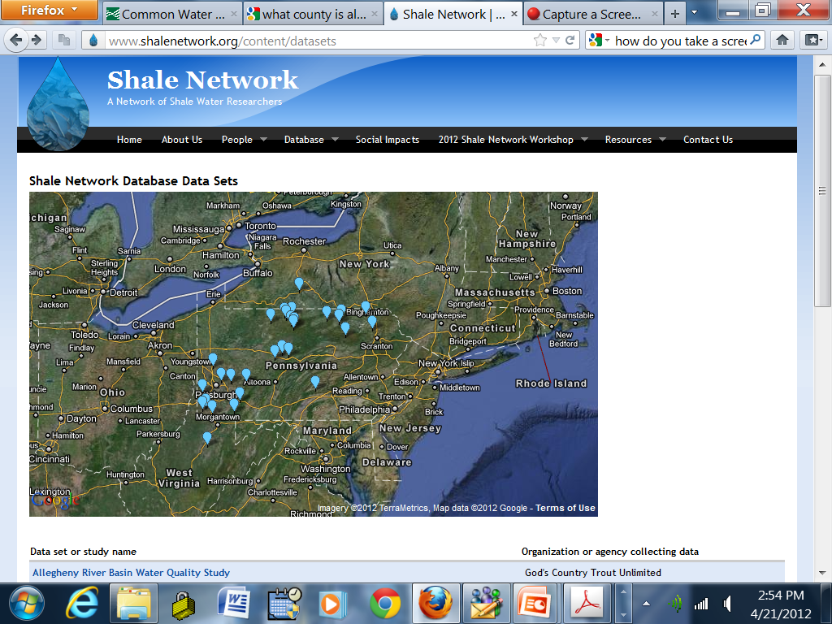
Our home page www.shalenetwork.org will always show the current datasets we have uploaded..screen shot from 2012

Slide 14
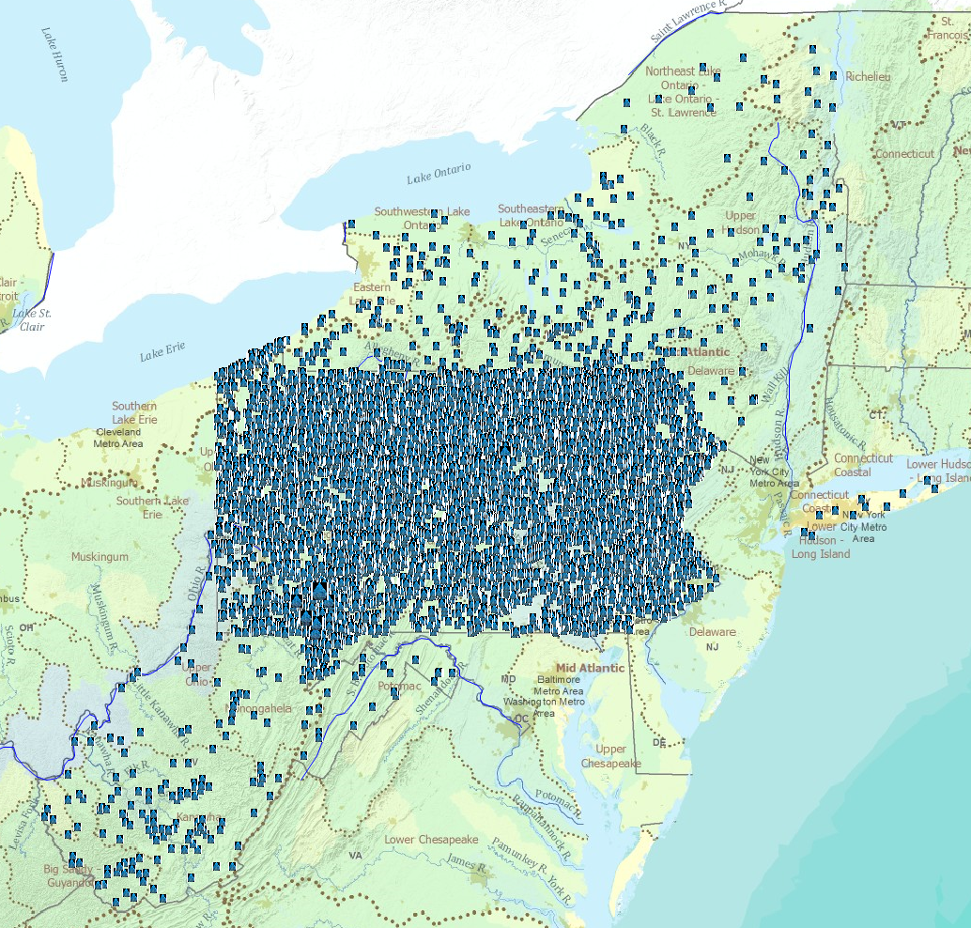
All Shale Network sites, May 2013
Time Series: 58,133
Sites: 22,904
Variables: 786
Total Values: 669,774

Slide 15
Marcellus flowback waters have a signature that you can see in the database
High TDS, Specific Conductance
Often have very high Na, Ca, Cl
Usually relatively high Ba, Sr, Br
Can have high NORMs (e.g., Ra)
Compared to AMD, relatively low concentrations of constituents such as H⁺, Fe and SO₄
Near-neutral pH
Based on data in database, conversations with Carl Kirby, Art Rose, Dave Yoxtheimer, publications, PADEP data, our own measurements

Slide 16
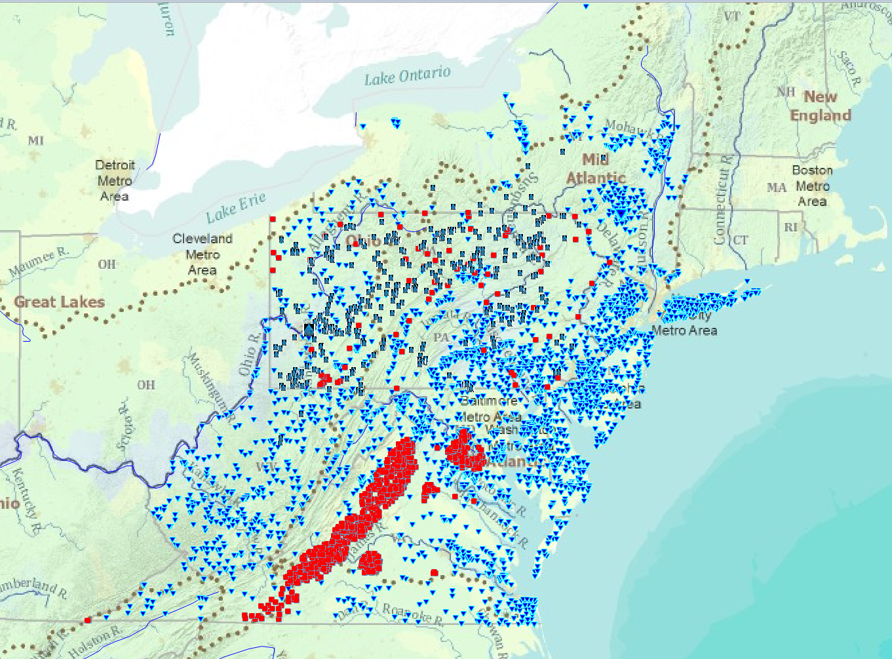
Bromide: all northeastern area
Blue triangles (USGS), Red squares (EPA), Black/blue rectangle (Shale Network)

Slide 17
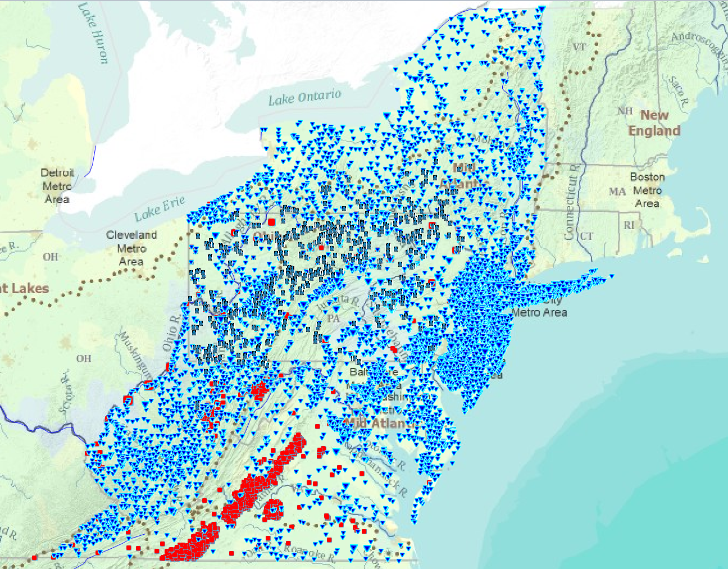
Barium: all northeastern area
Blue triangles (USGS), Red squares (EPA), Black/blue rectangle (Shale Network)

Slide 18
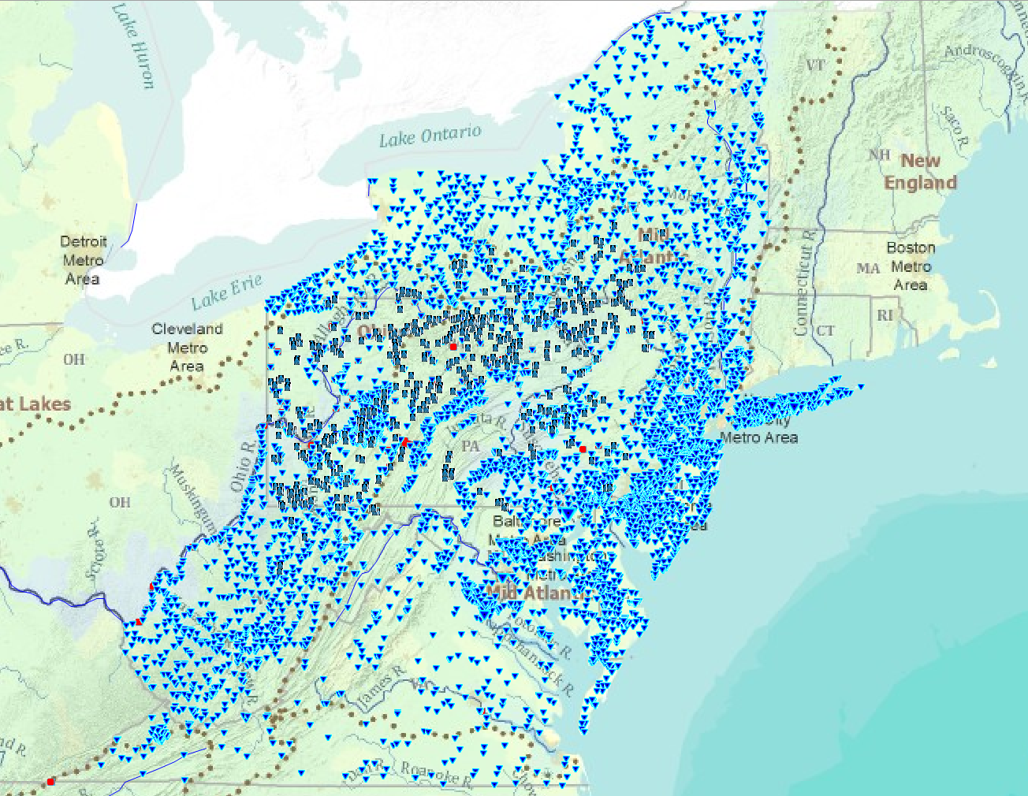
Strontium: all northeastern area
Blue triangles (USGS), Red squares (EPA), Black/blue rectangle (Shale Network)

Slide 19
Today’s Agenda
8:00-9:40 We tell you about what we are doing
9:40-10:05 We provide you with coffee
10:05 – 10:30 We walk to Willard Building
10:30-12:15 We teach you about HydroDesktop
12:30 -1:45 Lunch and Discussion
1:45 - 2:45 We break up into Small Groups (one Education-focussed group, 3 others)
2:45 – 4:00 Small Groups Report Back, General Discussion
4:00 – 4:30 Wrap up Comments
4:30 Assessment
4: 45 See you next year…

Slide 20

Welcome
And you
Notes:
This is where we will have Candie and Julie facilitate introductions

Slide 21
Closing Remarks
Notes:
This is for after the Small Groups return and discuss observations

Slide 22
Our Idea of the Shale Network
A network of data (we welcome all appropriate data …you can access the data with HydroDesktop)
A network of sites (sites where water quality or quantity data have been measured, see map at ShaleNetwork.org)
A network of developing knowledge (online information will enable understanding)
A network of people (people willing to share data…Please join us by registering at http://www.shalenetwork.org/user/register. We have an online forum and we welcome input)

Slide 23
I don’t want to put data into ShaleNetwork database .. how can I still share data?
Talk to Jon Pollak or Cesar Simon or Jorge Abad about setting up your own HydroServer
Talk to us and we will coordinate with you to make choices about uploading your data so that it will be most useful
We are more interested in helping put data online than we are in insisting that it go into the ShaleNetwork database: we want to help. (For example, we have interacted to help Wilkes Univ create their own database.)

Slide 24
Thank you!
The ShaleNetwork team includes Penn State (Sue Brantley, Maggie Peacock, Kathy Brasier, Dave Yoxtheimer, Greg O’Toole, Paul Grieve, X. Niu), Dickinson College (Candie Wilderman, Julie Vastine), Pitt University (Jorge Abad, Radisav Vidic, Cesar Simon, Sina Arjmand), CUAHSI (Rick Hooper, Jon Pollak)
We especially thank our staff, Debbie Lambert and Tracy Bernier for all the hard organizational work!

Slide 25
Please register to become a member of the ShaleNetwork and please share data
The Shale Network is open to people who monitor water quality, who research water issues, who facilitate water monitoring in areas of shale gas development, or who are members of organizations engaged in these activities. All members must be willing to share water quality or quantity data with the Network. To join, register at http://www.shalenetwork.org/user/register
Once you register, you can share data with us directly online and we will upload it
(If you do not want to be an official member, we will still accept data in any appropriate form)

